Slide 1
Machine Learning for Handwriting recognition and correction
Nasser Mohsen Nasser Saleh
Faculty of Artificial Intelligence in Education
Central China Normal University, Wuhan, China
Email: ennasseralfadly@gmail.com

Slide 2
Abstract
with the knowledge of current data about particular subject, machine learning tries to extract hidden information that lies in the data. By applying some mathematical functions and concepts to extract hidden information, machine learning can be achieved and we can predict output for unknown data. Patterns are usually recognized with the help of large image data-set, for the most part concentrating on the pre-printed or handwritten characters space. Since some spelling mistakes when handwriting recognizing in some words, we need a system that corrects the spelling mistakes words. By using such concepts, we can train computers to read letters and numbers belonging to any language present in an image. There exists several methods by which we can recognize hand-written characters. We will be discussing some of the methods in this paper.

Slide 3
1-Introduction
In the field of Machine Learning, recognition of objects has become most sought one. Some of the examples of object recognition are Face recognition, Hand write recognition, Disease detection etc. All these things can happen through large set of image data set. These image data set will contain both positive and negative data regarding that domain. This helps the algorithm to classify the unknown data in better ways. Hand write recognition is a new technology that will be useful in this 21st century. It can act as base functionality for the birth of new requirements. For example, a blind man cannot read newspaper unless braille format exists. In this case we can train the algorithm to recognize characters in the newspaper, store them as text and convert the text to speech. This can help lot of blind people to ease their daily work. The second application of hand write recognition could be language translation.
In this case when a person is dealing with non-native language, he can just take a image of a document and send it to the hand write recognition algorithm. This algorithm can recognize the characters in image and convert them to text. Then the text can be converted to desired language of choice. This research can be divided into six main steps. The first step is image source, the second is pre-processing stage, the third is segmentation, the fourth is feature extraction, the fifth is classification and the sixth is correction.
Handwritten character recognition is challenging and researchers have been exploring different techniques in the pass few decades. Recently, deep neural networks have drawn the attention of many researchers due to their capability of solving computer vision problem such as object detection, classification, recognition, etc. undoubtedly well. CNN is one of the most popular type of deep neural network, it can learn and extract features from the 2D images. The CNN classifier can effectively recognize characters present in the image. The architecture of traditional CNN classifier consists of convolutional layers for extracting features and fully connected layers followed by a soft-max layer for classification. CNN is an effcient feature extractor.

Slide 4
2-Problem statement
The goal of this project is to create a system capable of handwriting recognizing with high accuracy with identifying and correcting spelling mistakes.

Slide 5
3-Research questions
What are the pre-processing stages in handwriting recognition?
How to detect handwriting recognition?
How to correct spelling mistakes?

Slide 6
4-Methodology
Python is widely used for analyzing the data but the data need not be in the required format always. In such cases, we convert that format (like PDF or JPG etc.) to the text format, in order to analyze the data in better way. Python offers many libraries to do this task.
Python-tesseract is an optical character recognition (OCR) tool for python. That is, it will recognize and “read” the text embedded in images.

Slide 7
4.1 Optical Character Recognition (OCR)
OCR is Optical Character Recognition. In other words, OCR systems transform a two-dimensional image of text, that could contain machine printed or handwritten text from its image representation into machine-readable text. OCR as a process generally consists of several sub-processes to perform as accurately as possible. The subprocesses are:
Image source.
Pre-processing.
Segmentation.
Feature extraction.
Classification.

Slide 8
4.1.1 Image source
Image source this is the first stage in the proposed system. Process starts with the collection of images from data entry form documents that had been filled by handwritten text.

Slide 9
4.1.2 Pre-processing
Pre-processing is sequence of operation, that improves the quality of image and hence increases the accuracy of image. For the hand written character recognition process, the following pre-processing techniques are followed.
- Noise reduction It can be mostly eliminated by using median filter. Median filter is preserving edges in an images while decreasing random noise.
- Image binarization refers to the conversion of the gray scale images to a binary images. In our methodology, binarization is a function that turns the values of the pixels weights into two values. These values are black (weight 0) and white (weight 1).
- Thinning is a process which increases or thickens objects in the binary images. After applying binarization, another problem is appeared which is the erosion or broken characters.

Slide 10
4.1.3 Segmentation
Segmentation: the goal of a character segmentation algorithm is to partition a word image into regions, each containing an isolated complete character. The initial segmentation of characters can make the difference between very good and very poor results for recognition system. The operation starts by constructing a histogram done by counting the number of black pixels in each column.

Slide 11
4.1.4 Feature-extraction
Feature-extraction is the important phase in the recognition process, and the algorithm of recognition starts from here. Each character contains its own features. It contains group of rules where each rule explains feature of a character. Extraction of such features is done in this phase.

Slide 12
4.1.5 Classification
Classification by this time, the training would have completed and the testing of input data starts. The testing data would pass all the above process and the varying probabilities are assigned to the matching rules. The rule with highest probability is selected and the corresponding class-label is made recognized character.

Slide 13
CNN
CNN is abbreviated form of Convolution Neural Network. Convolution refers to twisted or coiled. Any neural network is similar to human brain. Neural networks are designed by taking inspiration from brain. CNN is mainly used for Image classification. CNN consists of many layers depending on the requirements.

Slide 14
CNN
Computer
vision
Artificial
Intelligence
Machine
Learning
Neural
Network
Deep
Learning
Convolutional Neural Network (CNN)
Convolution
layer
Pooling
layers
Fully connected
layer

Slide 15
Convolution layer
Convolution layer the idea of image classification is because of capability of pattern detection in convolution layer. The input to this layer is the image matrix of form width*height*depth. Depth in the matrix refers to the number of channels in the image. For gray-scale image, number of channels would be one, where as for RGB image number of channels would be three. We can convert the RGB image to gray-scale image and perform CNN operation over it.

Slide 16
Convolution layer
The convolution layer uses matrix called kernel or filter. This filter tells the pattern that we want to recognize. For recognizing the top horizontal edge, following filter is used as represented in below table.The matrix representation of character image is extracted. The pre-processing stage is performed on the image to remove noise and other unwanted data if present. We can also perform dimensionality reduction on the image as part of pre-processing. The filter is multiplied with a sub-matrix of same size in image. The multiplication starts from top left corner. The multiplication is dot product, not the usual matrix multiplication. The resultant of the dot product is stored in the top left corner and the filter is moved to next sub-matrix. The filter is multiplied with every possible sub-matrix in image.
The role of the ConvNet is to reduce the images into a form which is easier to process, without losing features which are critical for getting a good prediction.

Slide 17
Input image =n*n =5*5
Filter =f*f =3*3
Output image =3*3
n-f+1 * n-f+1
5-3+1 * 5-3+1
Example for a filter
The filter moves to the right with a certain Stride Value till it parses the complete width. Moving on, it hops down to the beginning (left) of the image with the same Stride Value and repeats the process until the entire image is traversed.
The filter shifts 9 times because of Stride Length = 1 (Non-Strided), every time performing a matrix multiplication operation between f and the portion P of the image over which the filter is hovering.

Slide 18
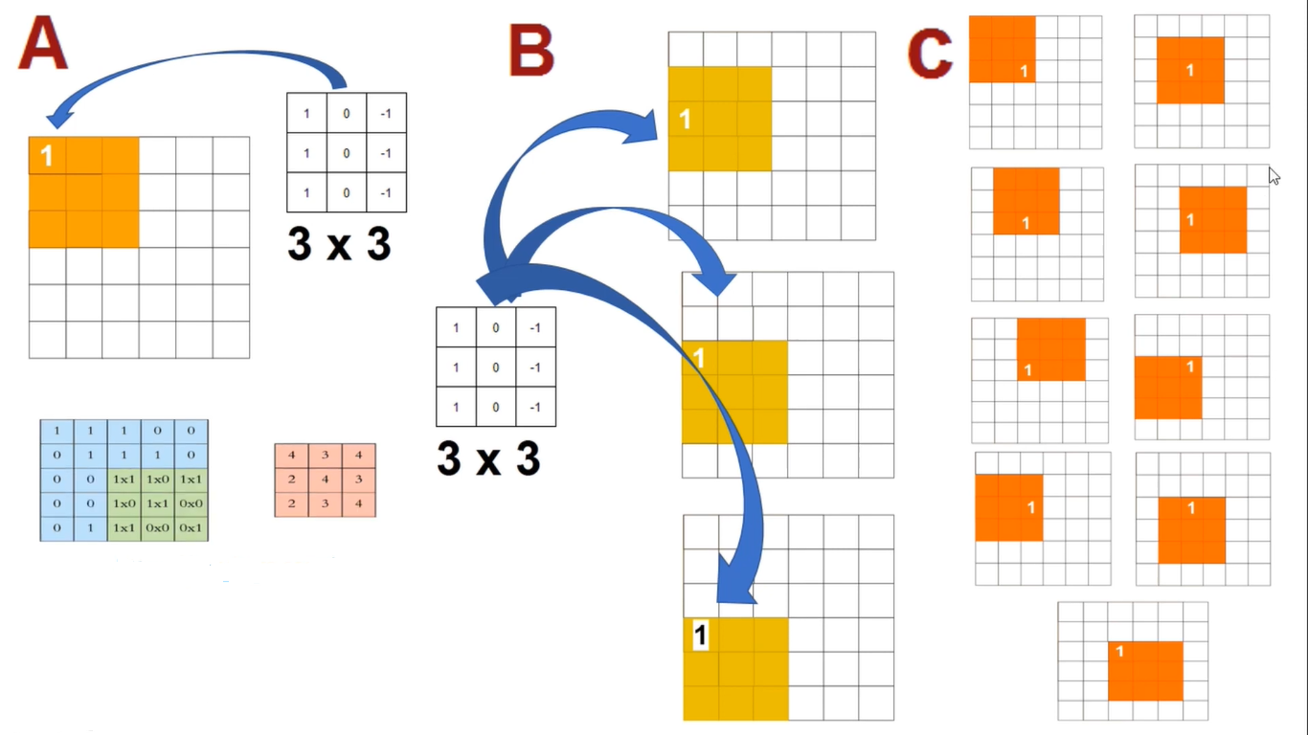
Loss of information about image corners

Slide 19
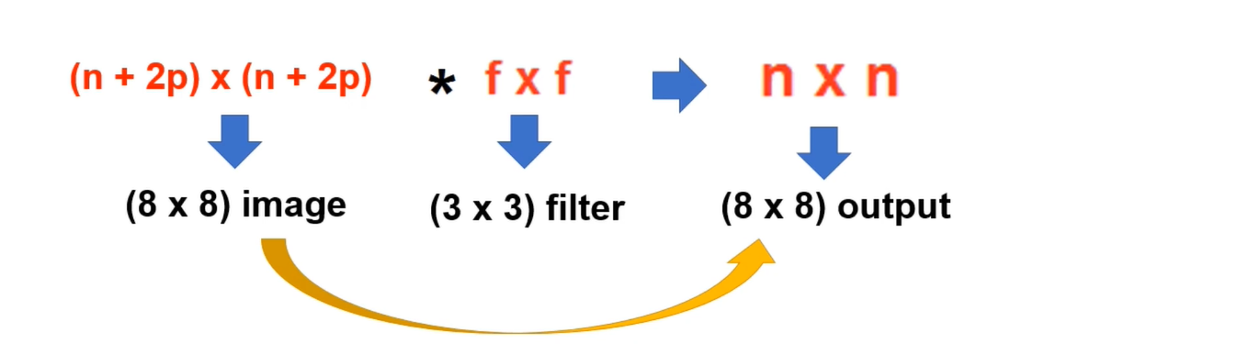
Padding
Valid Padding (No additional layer)
Same Padding (adding layer)

Slide 20
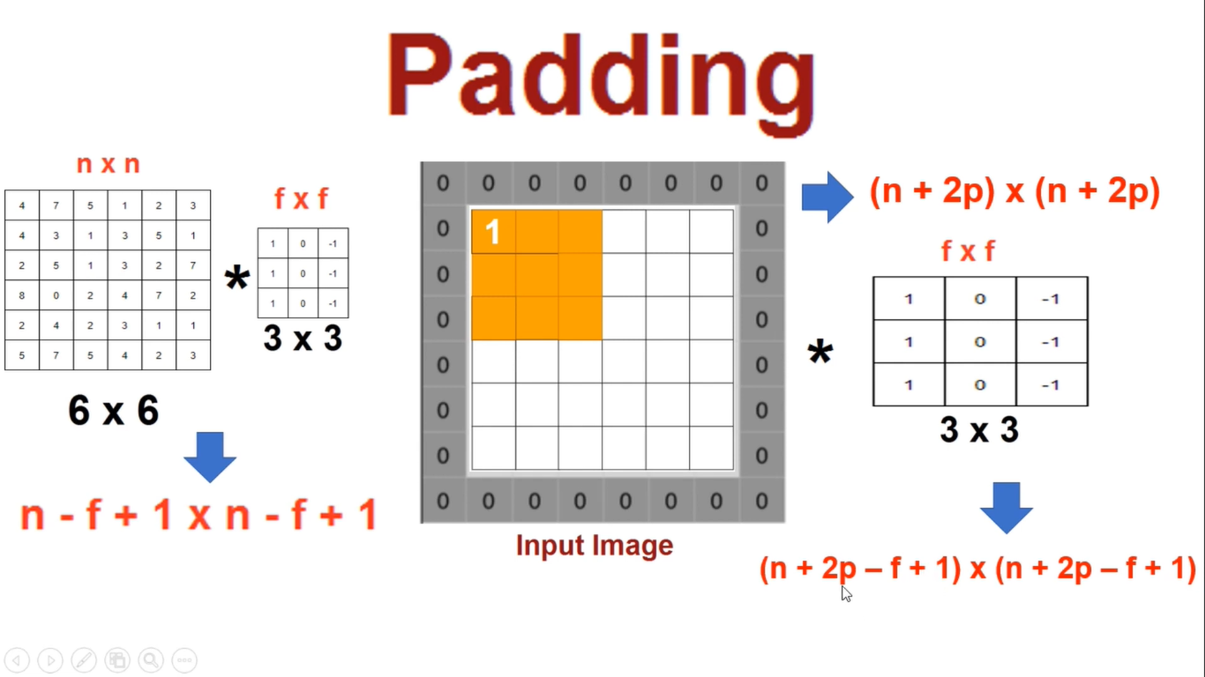

Slide 21
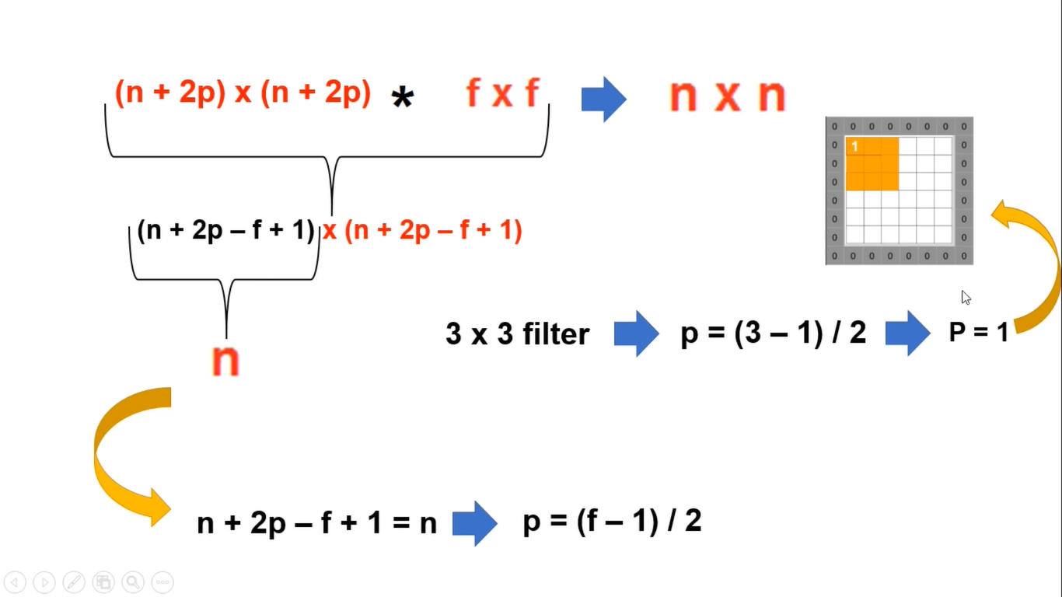

Slide 22
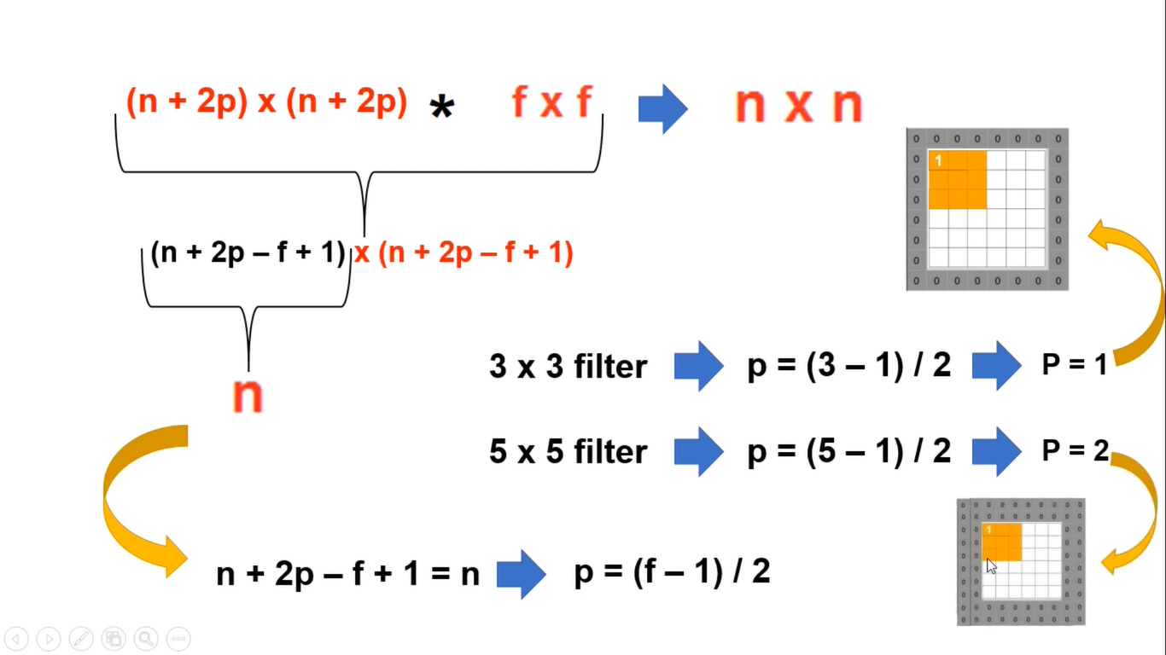

Slide 23
Why would one use larger strides in convolutional NNs, as opposed to smaller strides?
Smaller strides lead to large overlaps which means the Output Volume is high. Larger strides lead to lesser overlaps which means lower output volume . So these are the advantages of higher strides :
Lesser Memory needed for output
Processing of output is easier as the volume is smaller
The Output Spatial dimensions are smaller which when given as an input to the next layer simplify the model at least.
It avoids Overfitting especially in case of image processing having a large no. of attributes .

Slide 24
Strides
Strides=(2,2)

Slide 25
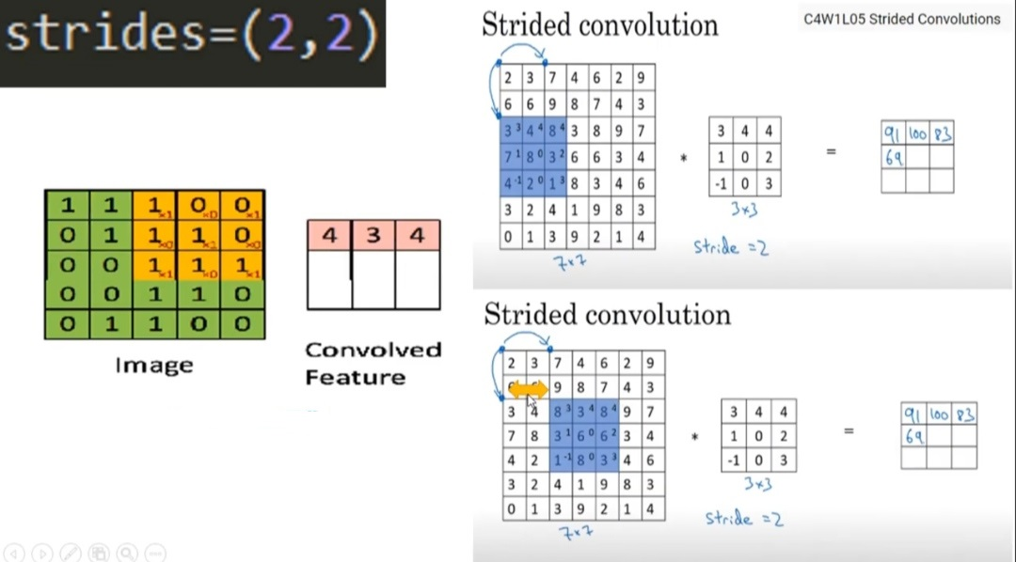
Strides

Slide 26
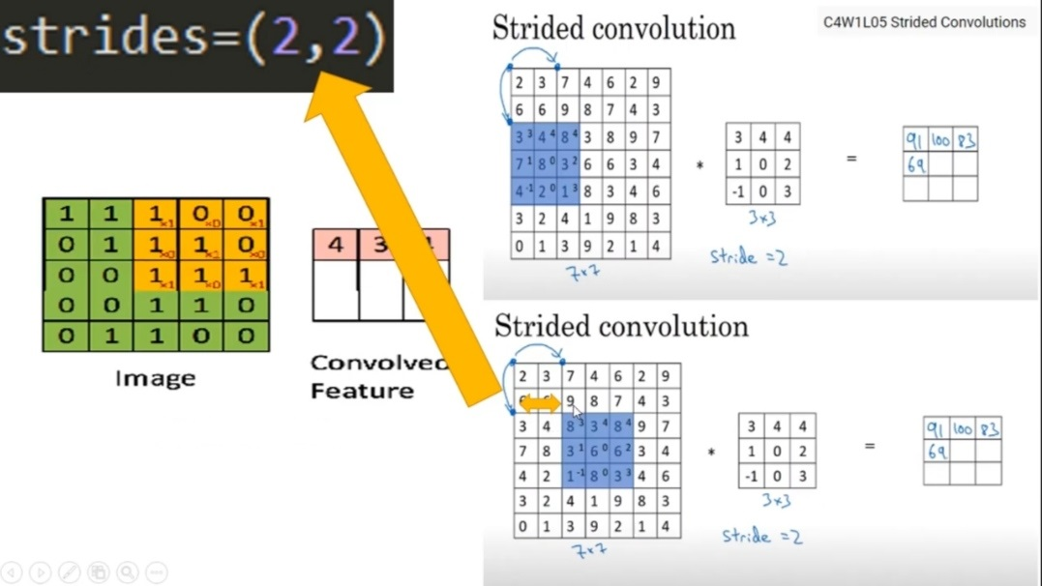

Slide 27
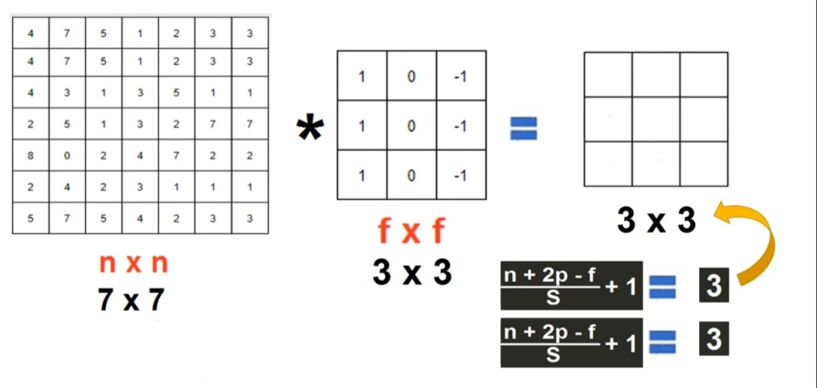

Slide 28
Thank you

